Slide 1
Progress for big data in Kubernetes
Ted Dunning

Slide 2
kubernetes is coming!

Slide 3
why?

Slide 4
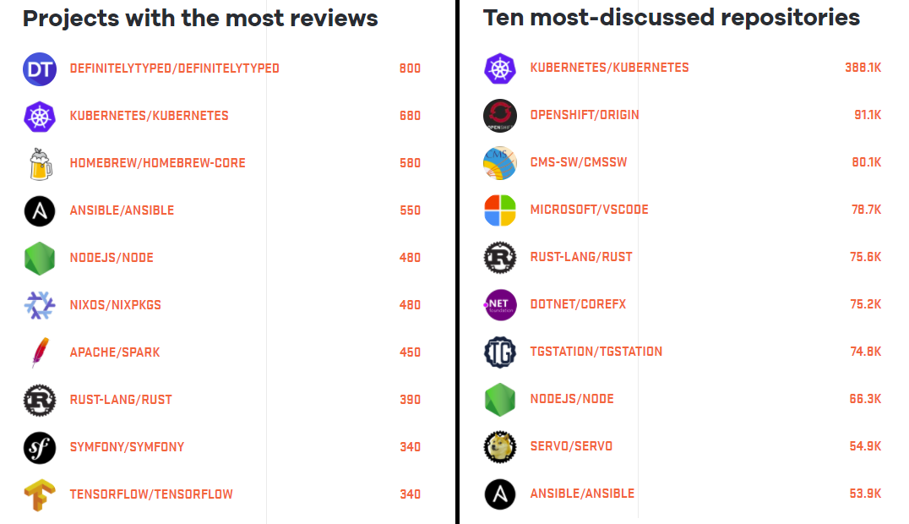
kubernetes = major community support
Source: Shippable.com http://blog.shippable.com/why-the-adoption-of-kubernetes-will-explode-in-2018

Slide 5
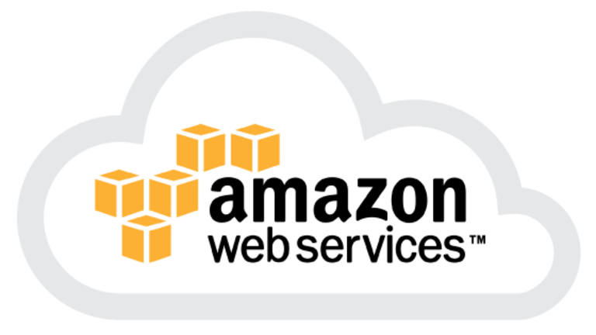
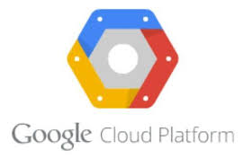
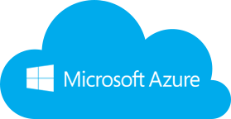
every cloud supports kubernetes
https://www.sinax.be/en/aws/
https://www.westconcomstor.com/za/en/vendors/wc-vendors/microsoft-azure-EN-UK.html
https://www.g2crowd.com/products/google-kubernetes-engine-gke/details

Slide 6
massive customer adoption rate

Slide 8
what is kubernetes?

Slide 9
kubernetes (n.) - greek word for pilot or helm

Slide 10
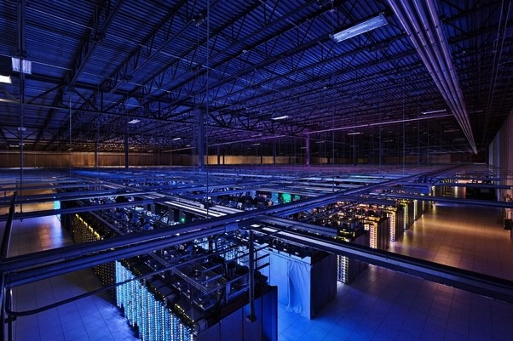
kubernetes started life as a successor to google’s borg project...
https://cloud.google.com/security/encryption-in-transit/

Slide 11
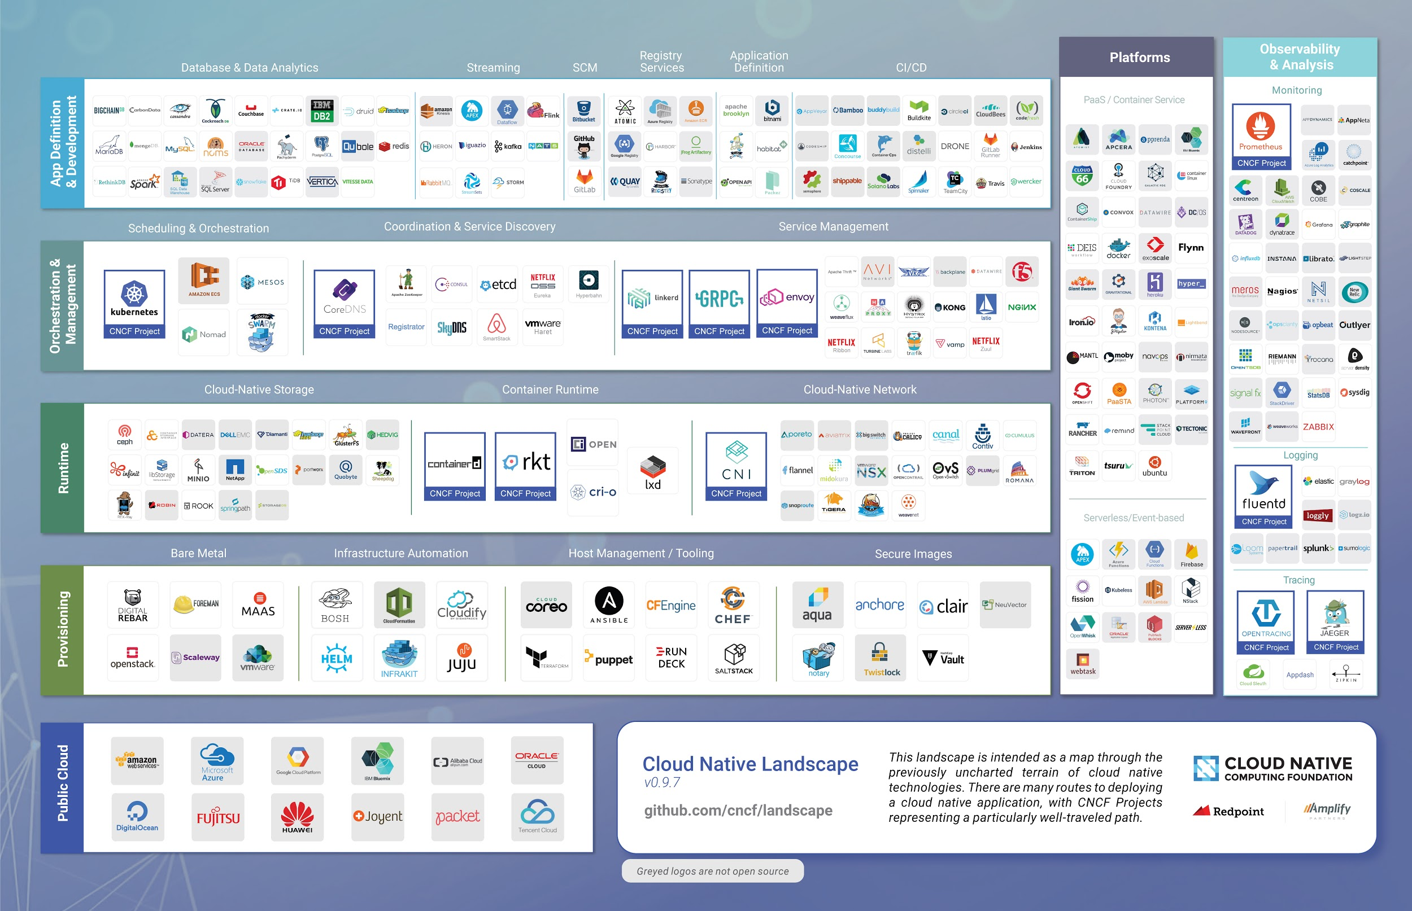
kubernetes is an ecosystem...
Source: Redmonk - http://redmonk.com/sogrady/2017/09/22/cloud-native-license-choices/

Slide 12
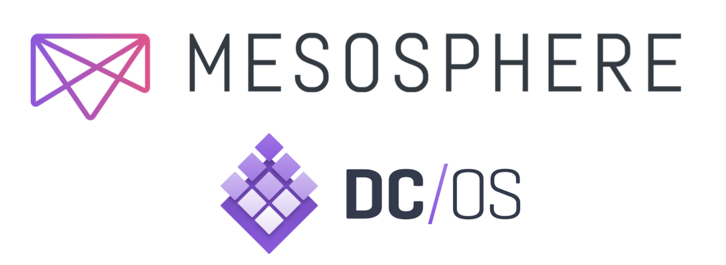

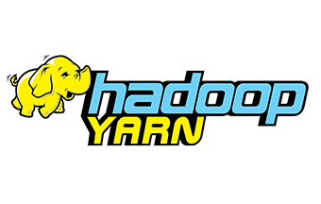
container and resource orchestration engine...

Slide 13
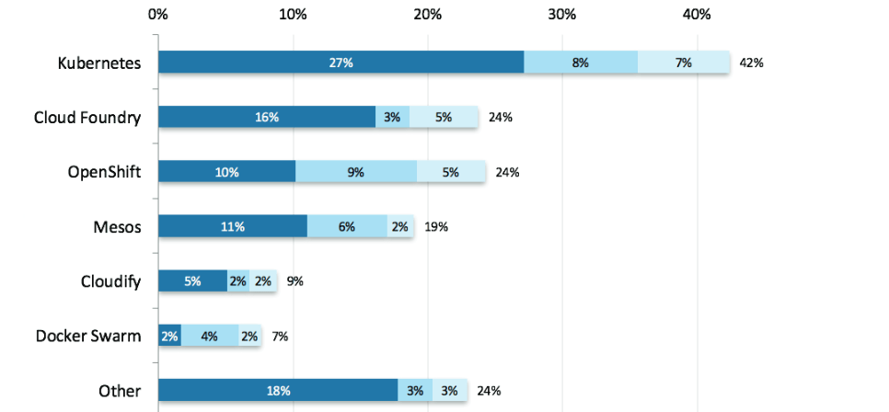
kubernetes won the container orchestration war...
Source: Shippable.com http://blog.shippable.com/why-the-adoption-of-kubernetes-will-explode-in-2018

Slide 14
what is kubernetes?

Slide 15
it runs containers

Slide 16
what is a container?

Slide 17
not a vm

Slide 18
vm vs container
vm
vm
app
app
libs
libs
container
container
container
os
os
app
app
app
libs
libs
libs
hypervisor
os
os
hardware
hardware

Slide 19
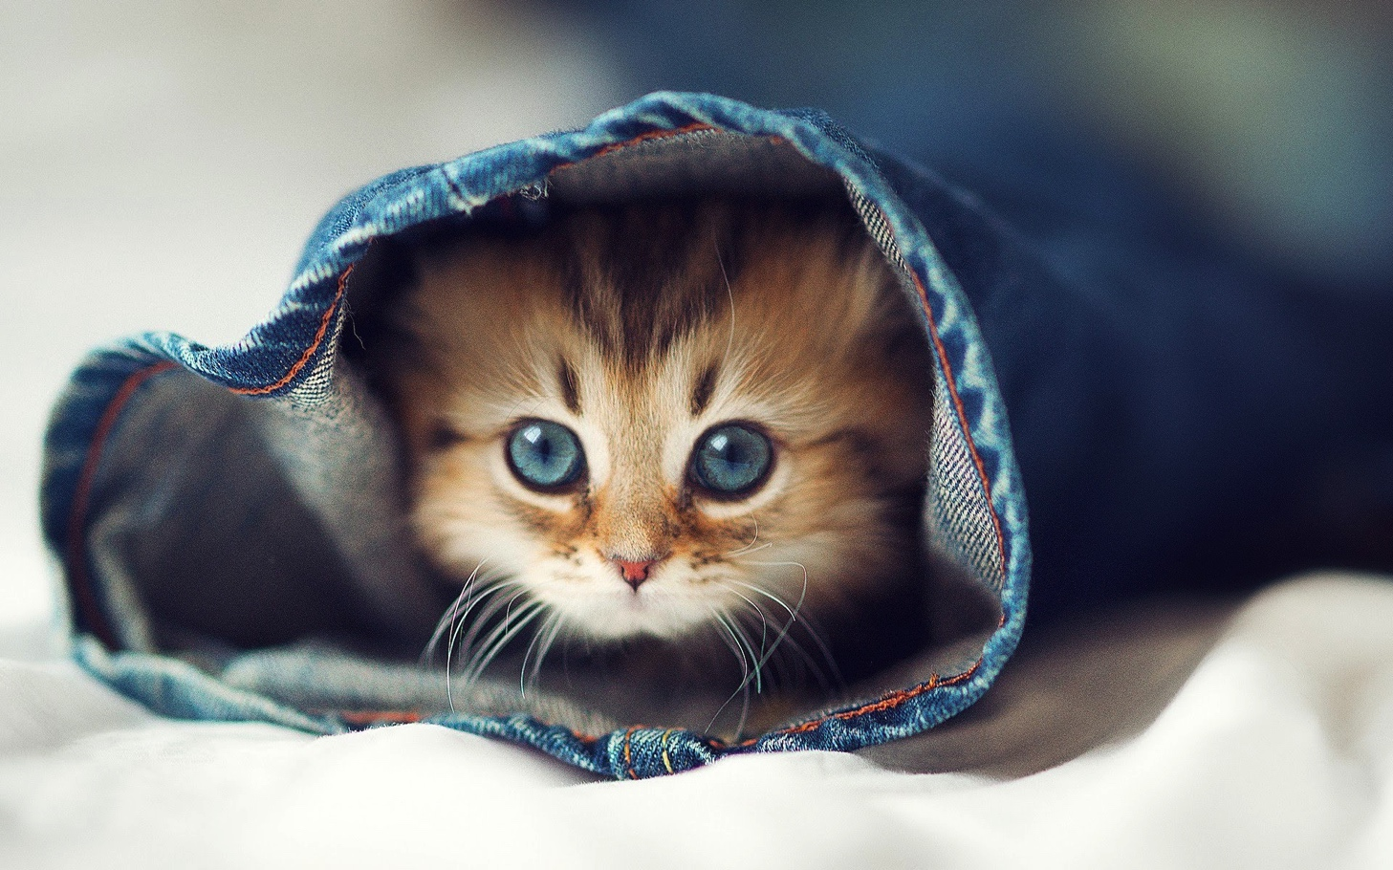
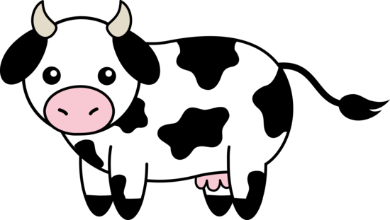
pets vs cattle
https://fwallpapers.com/view/cat-jeans
http://www.clipartpanda.com/clipart_images/free-clip-art-1083418

Slide 20
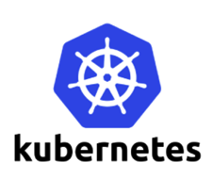
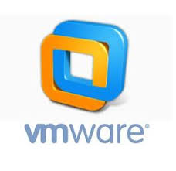
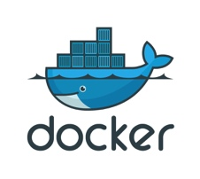
pets vs cattle
- long lived
- name them
- care for them
- ephemeral
- brand them with #’s
- well..vets are expensive

Slide 22
isolation
cgroups
cpu
memory
network
etc.
namespaces
pids
mnts
etc.
Chroot (filesystem)

Slide 23
container images
File
File
Read-only Layer

Slide 24
container images
File
Read-only Layer
File
File
Read-only Layer

Slide 25
container images
Writable Layer
File
Read-only Layer
File
File
Read-only Layer

Slide 26
container = image + isolation
cgroups
cpu
memory
network
etc.
namespaces
pids
mnts
etc.
File
File
File
Container Image
chroot

Slide 27
containers have a problem

Slide 28

you can never get away from pets unless:
- you handle the problem of container state
- you need an environment to support cattle
MapR and kubernetes are the solution

Slide 29
Things docker can’t (or won’t) do...
solve port mapping hell
monitor running containers
handle dead containers
move containers so utilization improves
autoscale container instances to handle load

Slide 30
Magical View of Kubernetes

Slide 31
Magical View of Kubernetes

Slide 32
Magical View of Kubernetes

Slide 33
Magical View of Kubernetes

Slide 34
Note that you don’t think about which machine at all

Slide 35
You don’t think about which machine at all
No more names from The Hobbit
Just cattle

Slide 36
The Impact of Kubernetes
Software engineering can be viewed as freezing bits
Initially, everything is possible, nothing is actual
We freeze the source
Then the binary
Then the package
Then the environment
Ultimately the system

Slide 42
This is glorious

Slide 43
but we still have a problem

Slide 44
state

Slide 45
Not Done Yet

Slide 46
Not Done Yet

Slide 47
Not Really Ready at All
State in containers messes things up
Restarts lose the state
Replicating state makes services complex
Application developers just aren’t systems developers
State life-cycle doesn’t match app life-cycle

Slide 48
What is a Service Anyway?

Slide 49
But … Not Entirely
Synchronous RPC-based services only serve one need
In a synchronous service it’s common to do some, defer some
But deferring work is hard in a synchronous world … we have to give up the return call in some sense
This is the germ of streaming architecture

Slide 50
What is a Service Anyway?

Slide 51
Isolation is The Defining Characteristic
If I can hide details of who and where, I have a service
If I can hide details of deployment, I have a micro-service
If I can hide details of when, I have a streaming micro-service

Slide 52
Temporal and Geo Isolation
Consumer isn’t even running

Slide 53
Temporal and Geo Isolation

Slide 54
Temporal and Geo Isolation
Consumer could be an ocean away

Slide 55
We Need Multiple Forms of Persistence
Files are important
Config files, image files, archival data data
Legacy applications like machine learning, web
Tables are important
Critical to have random update for some applications
Should scale transparently without dedicated cluster
Streams are important
Should be co-equal form of persistence

Slide 60
What Does This Data Platform Need to Have?
Global namespace across entire Kubernetes cluster
Between clusters as well if possible
All three forms of primitive persistence
Files, streams, tables
Inherently scalable
Performance, cardinality, locality
Uniform access and control
Path names for all objects, identical permission scheme

Slide 61
What Does This Data Platform Need to Have?
Global namespace across entire Kubernetes cluster
Between clusters as well if possible
All three forms of primitive persistence
Files, streams, tables
Inherently scalable
Performance, cardinality, locality
Uniform access and control
Path names for all objects, identical permission scheme
Oh…. got that already. Just need to wire it up to Kubernetes

Slide 62
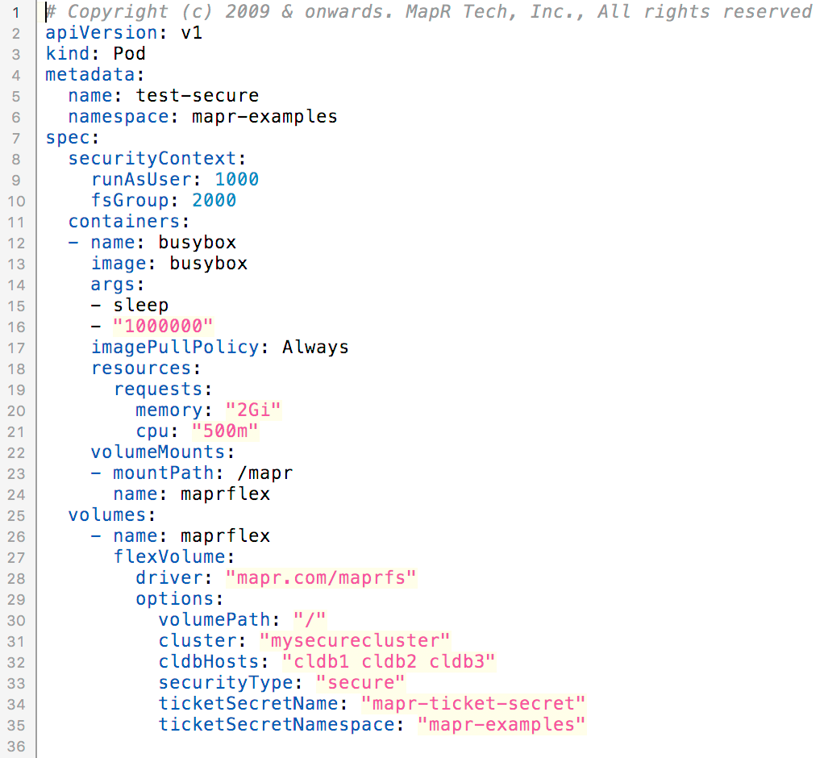

Slide 64
Normally pods interact directly with node resources

Slide 65
We can install a volume plugin (recently introduced)

Slide 66
This allows uniform access to files, tables and streams

Slide 67
Where does that take us?

Slide 68
Consequences
Installation of plugin is K8S level operation
No per-node attention required
Use of plugin is overlay operation
No change needed for an container
Any Helm chart can use the plugin for conventional file access
Can share storage/compute or isolate or scale independently

Slide 69
More Consequences
State is no longer a dirty word for Kubernetes
HPC can run on K8S
Boring things can run on K8S without storage appliances
Previously crazy ideas can now be valuable
Complexity is largely not visible

Slide 70
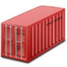



Cloud as-is: No unified data access or security concepts
Single cloud vendor strategy:
Vendor lock in
No failover in case of global outage
Limited Edge capabilities
Application
API Connector
✓
API
AWS Services:
Kinesis & Elastic MapReduce
Redshift & DynamoDB
S3 & Glacier
Public Cloud

Slide 71

Cloud as-is: No unified data access or security concepts
Multi cloud strategy:
Complex data movement between clouds
On any other cloud:
Different API‘s: application breaks
Different Security concept
Application
API Connector
✓
API
API
AWS Services:
Kinesis & Elastic MapReduce
Redshift & DynamoDB
S3 & Glacier
Azure Services:
HD Insight
SQL Server & CosmosDB
Blob & DataLakeStore
Public Cloud

Slide 72


Cloud as-is: No unified data access or security concepts
Multi cloud strategy:
Complex data movement between clouds
On any other cloud:
Different API‘s, application breaks
Different Security concept
Application
API Connector
✓
API
API
API
API
API
Edge
Private Cloud
On Premise
Public Cloud
Public Cloud
Public Cloud

Slide 73


How a “Media Company” is using MapR
Unified Security Model
Data access decoupled from physical storage location. Globally.
No lock-in to proprietary APIs
Full openness
Data made portable
Application
API Connector
✓
Open APIs
Uniform computing environment everywhere
GLOBAL DATA MANAGEMENT
Edge
Private Cloud
On Premise
Public Cloud
Public Cloud
Public Cloud

Slide 74
How “Manufacturing Company” is using MapR
Unified Security Model
Data access decoupled from physical storage location. Globally.
No lock-in to proprietary APIs
Full openness
Data made portable
Application
API Connector
✓
GLOBAL DATA MANAGEMENT
Open APIs
Platform level data replication
Edge
Private Cloud
On Premise
Public Cloud
Public Cloud
Public Cloud

Slide 75




Tier 1 Bank #1 Creating a Global Filesystem
Application
✓
NFS
POSIX
REST
HDFS
Kafka
JSON
HBASE
SQL
S3
/mapr
Global access to local data
HOT
WARM
COLD
/mapr/edge1
/mapr/edge3
/mapr/aws-eu-west
/mapr/amsterdam
/mapr/edge2
/mapr/newyork
/mapr/azure
/mapr/gcp

Slide 76
Tier 1 Bank #2: Creating an “Ubernetes” Platform with MapR
Application
Pod
Pod
Pod
Classic ETL
Image Classification using Tensorflow in a Docker container
Scheduling & Scaling
MapR Kubernetes Volume Driver
Single pane of glass to control jobs anywhere
GLOBAL DATA MANAGEMENT
Edge
Private Cloud
On Premise
Public Cloud
Public Cloud
Public Cloud

Slide 77
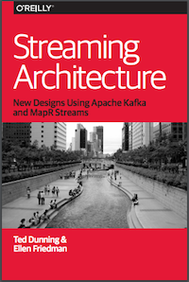
Additional Resources
O’Reilly report by Ted Dunning & Ellen Friedman © September 2017
Read free courtesy of MapR:
https://mapr.com/ebook/machine-learning-logistics/
O’Reilly book by Ted Dunning & Ellen Friedman © March 2016
Read free courtesy of MapR:
https://mapr.com/streaming-architecture-using-apache-kafka-mapr-streams/

Slide 78

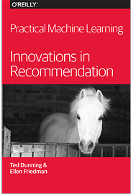
Additional Resources
O’Reilly book by Ted Dunning & Ellen Friedman
© June 2014
Read free courtesy of MapR:
https://mapr.com/practical-machine-learning-new-look-anomaly-detection/
O’Reilly book by Ellen Friedman & Ted Dunning © February 2014
Read free courtesy of MapR:
https://mapr.com/practical-machine-learning/

Slide 79
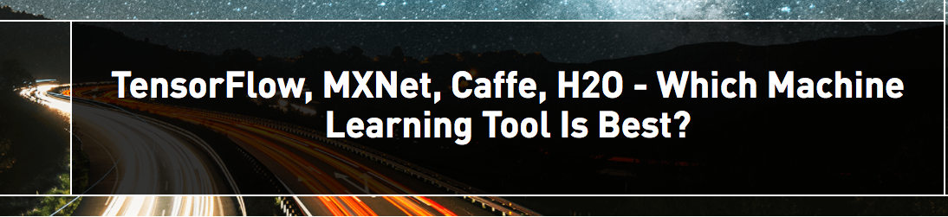
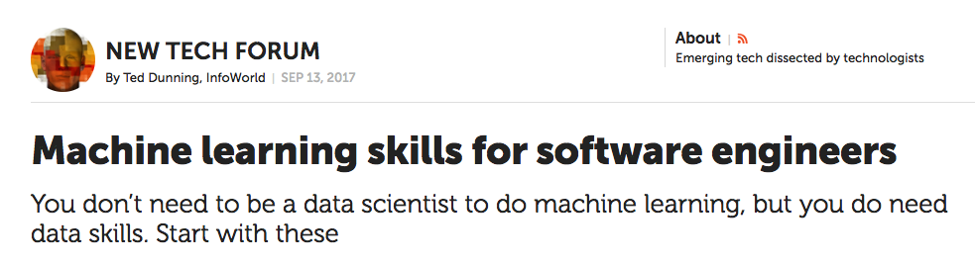
Additional Resources
by Ellen Friedman 8 Aug 2017 on MapR blog:
https://mapr.com/blog/tensorflow-mxnet-caffe-h2o-which-ml-best/
by Ted Dunning 13 Sept 2017 in InfoWorld:
https://www.infoworld.com/article/3223688/machine-learning/machine-learning-skills-for-software-engineers.html

Slide 80
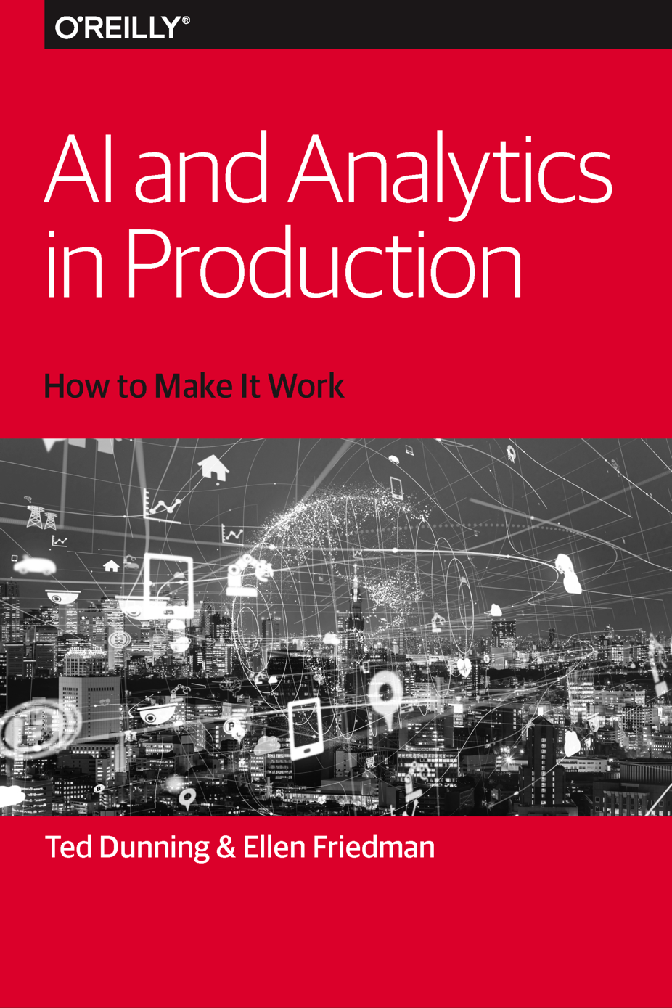
New Book!
We will be signing this book at the MapR booth later today.
Detailed schedule at the booth.

Slide 81

Please support women in tech – help build girls’ dreams of what they can accomplish
#womenintech #datawomen
© Ellen Friedman 2015

Slide 82


ENGAGE WITH US
Q&A
@ Ted_Dunning
@mapr
tdunning@mapr.com

